Slide 1
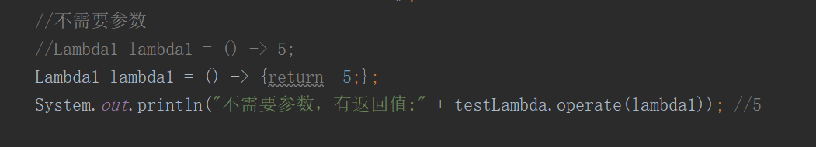
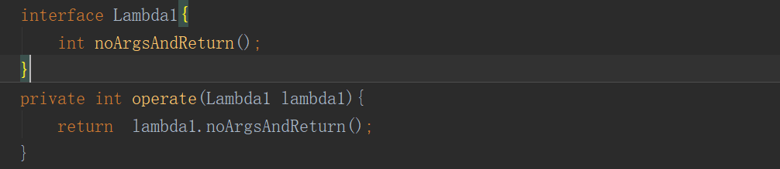
Lambda expressions
Lambda Expressions:
(parameters) -> expression or (parameters) ->{ statements; }
Eg:

Slide 2
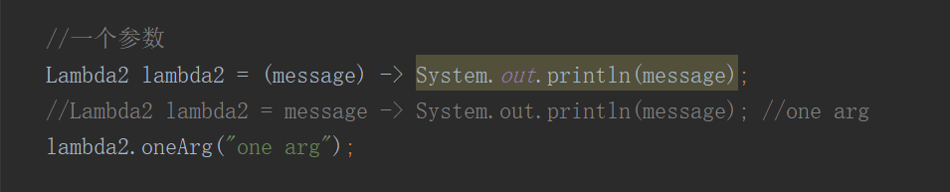
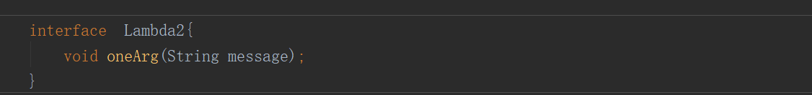
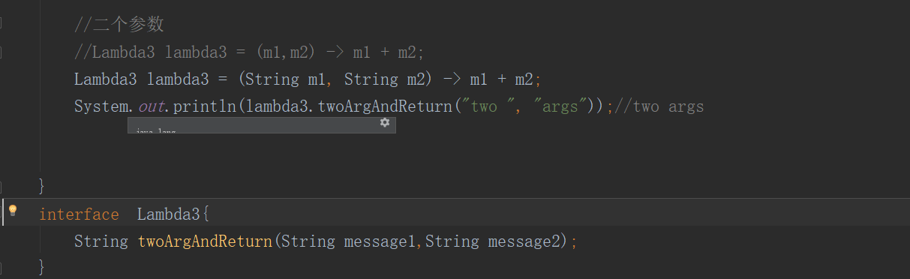
Lambda

Slide 3
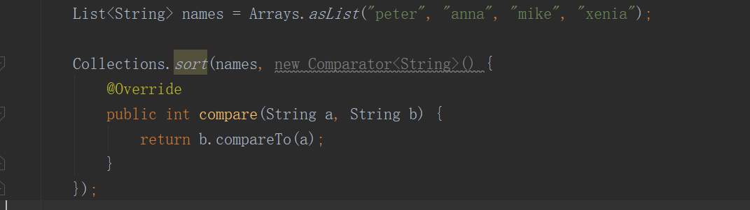
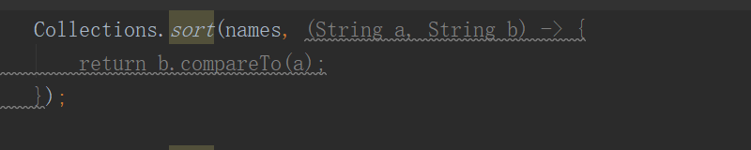
Lambda expressions

Slide 4
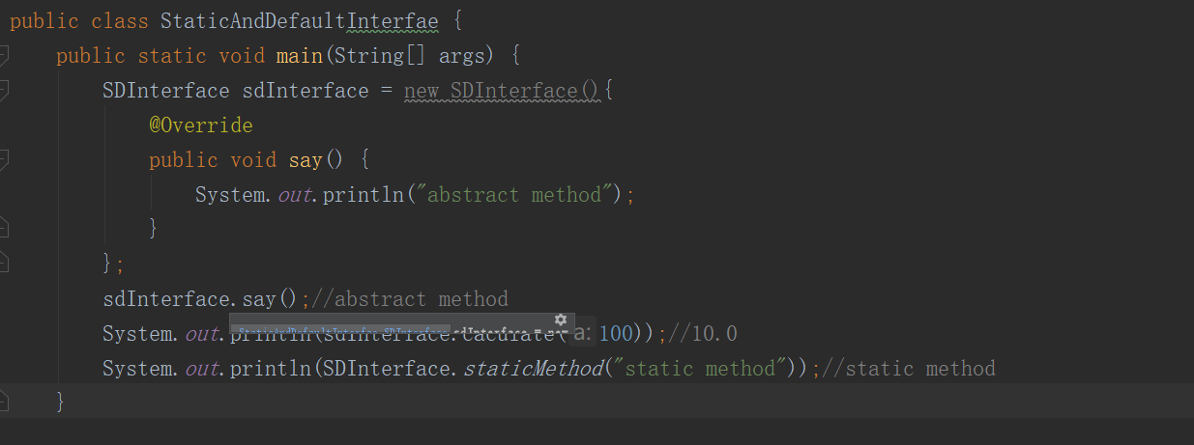
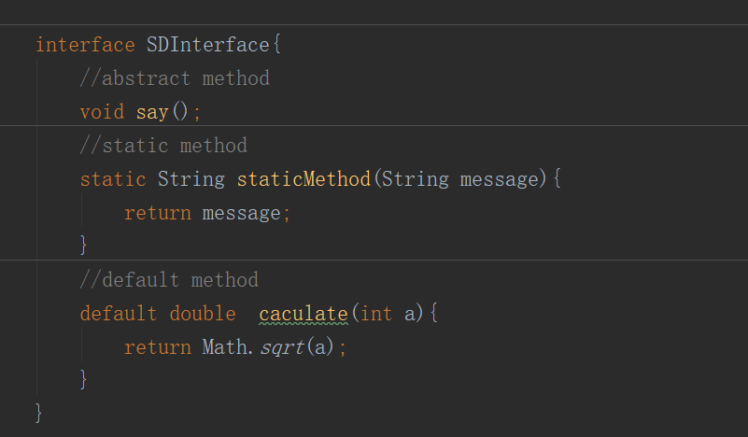
Default And Static Method for Interfaces

Slide 5
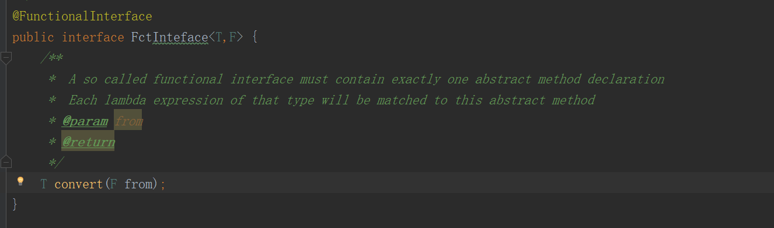
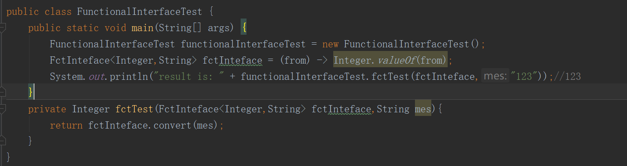
Functional Interfaces

Slide 6
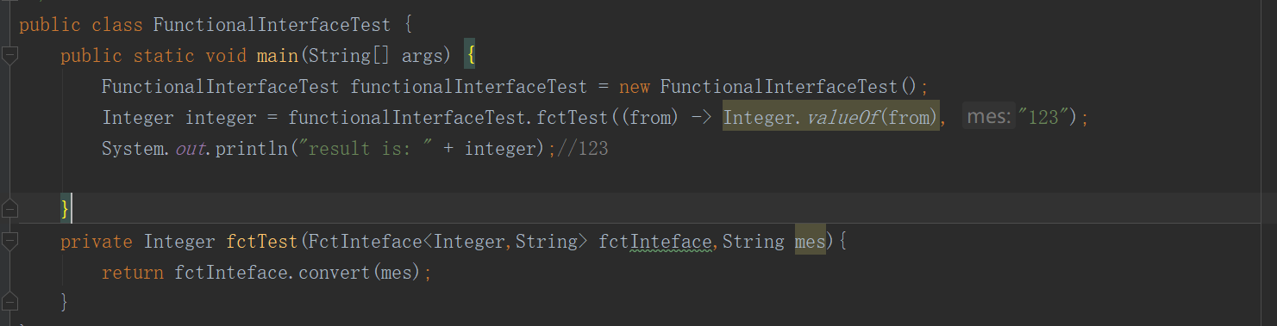
Functional Interfaces
Noted:
To ensure that your interface meet the requirements, you should add the @FunctionalInterface annotation.you should add the @FunctionalInterface annotation.The compiler is aware of this annotation and throws a compiler error as soon as you try to add a second abstract method declaration to the interface.

Slide 7
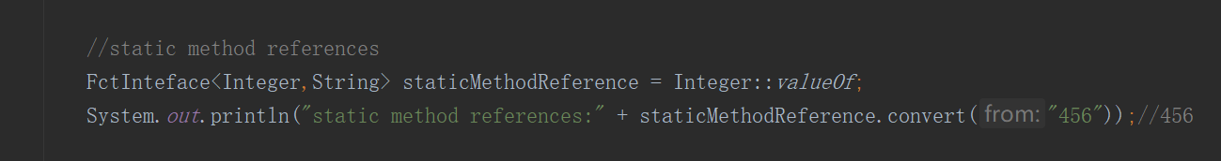
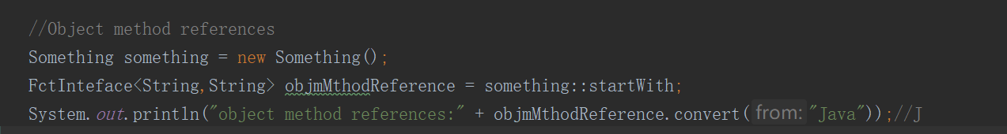
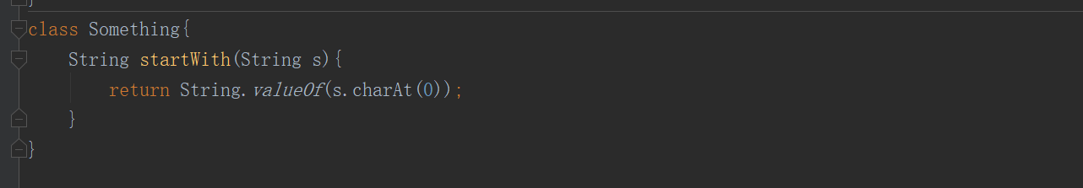
Method and Constructor References
static method references
object method references

Slide 8
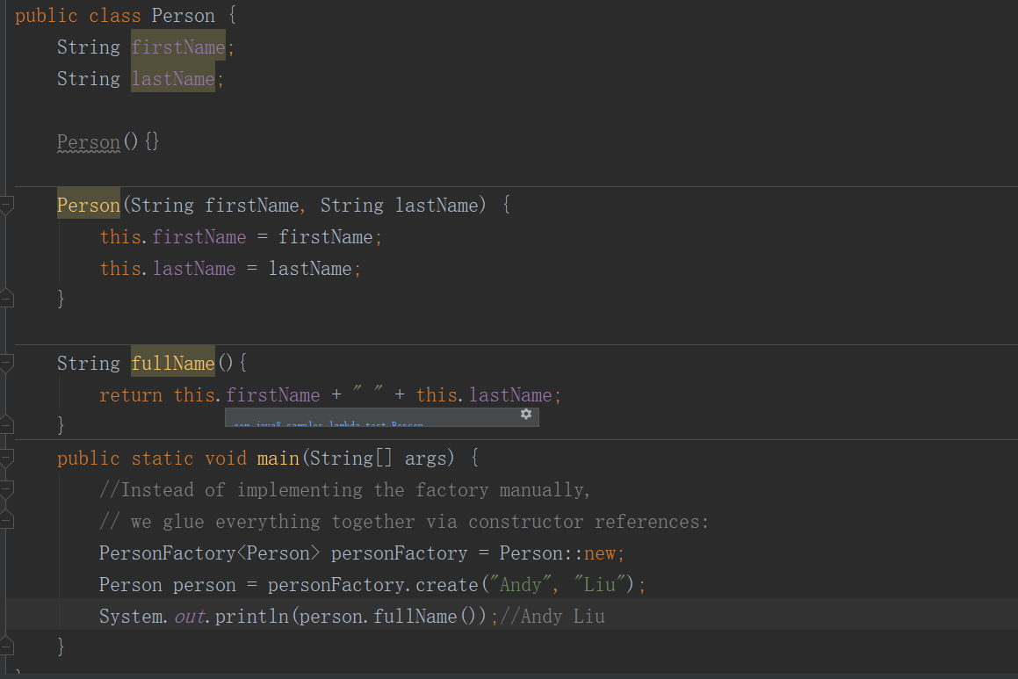
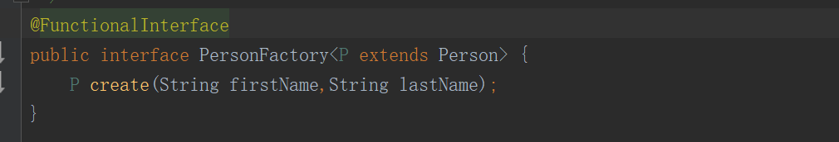
Method and Constructor References
constructor references

Slide 9
Reference
https://github.com/andyliuzhong/java8-tutorial#lambda-expressions

